Slide 1

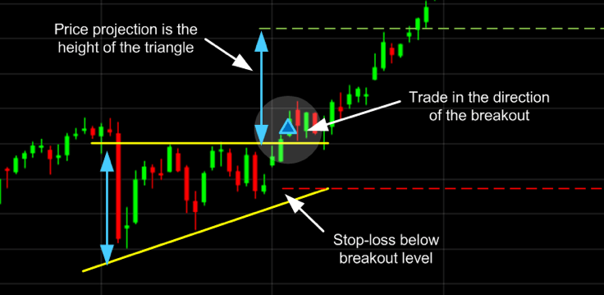
Gayatri Vidya Parishad College Of Engineering(Autonomous)
STOCK ANALYZER USING PYTHON
Under the guidance of
Ch. Venkanna
Assistant Professor
Dept. of E.C.E.
Presented by
S.BABU RAO(19131A04L2)

Slide 2
Table of contents
1.Introduction to stock analyzer using python
2.Tools and Technologies
3.Importing standard libraries
4.Automation using selenium
5.Operation on the information obtained
6.Sequence of steps to Send an email using smptlib module
7.code
8.Output screens
9.Benefits
10.Conclusion
11.Future enhancements
12.References

Slide 3

Introduction to stock analyzer
Everyone in this world is busy and we often forget things. Motivated by these two statements, I decided to build a simple cryptocurrency price alert microservice that will send an email notification if the price of a specified coin goes above/below a certain threshold.
You no longer need to stare at the market to check the price all day. All you need to do is choose the currency and specify the threshold price. That’s it. You’ll get notified via the provided email address

Slide 4


Tools and Technologies
Software : visual studio code
Visual Studio Code is a source-code editor made by Microsoft for Windows, Linux and macOS. Features include support for debugging, syntax highlighting, intelligent code completion, snippets, code refactoring, and embedded Git.
Programming language :Python
Python is an interpreted, object-oriented, high-level
programming language.
Python is simple, easy to learn syntax emphasizes readability.
Python supports modules and packages, which encourages program modularity and code
reuse.

Slide 5
2.IMPORTING STANDARD LIBRARIES
import smtplib
from selenium import webdriver
from selenium.webdriver.common import keys
from selenium.webdriver.support.ui import Select
from selenium.webdriver.common.keys import Keys
from selenium.webdriver.common.by import By
from selenium.webdriver.support.ui import WebDriverWait
from selenium.webdriver.support import expected_conditionsas EC
import time

Slide 6
3.AUTOMATION USING SELENIUM
Selenium is an open-source umbrella project for a range of tools and libraries aimed at supporting web browser automation. Selenium provides a playback tool for authoring functional tests without the need to learn a test scripting language (Selenium IDE).
From selenium we import webdriver to use automation using browser.
From selenium we import keys:
Special Keys is an exclusive feature of Selenium in python, that allows pressing keys through keyboard such as ctrl+f, or shift+c+v, etc. class selenium.webdriver.common.keys.Keys handles all Keys in Selenium Python. It contains huge number of key methods one can use in Selenium Python.
3.From time we import sleep:
sleep function is used to provide some delay to the program.

Slide 7
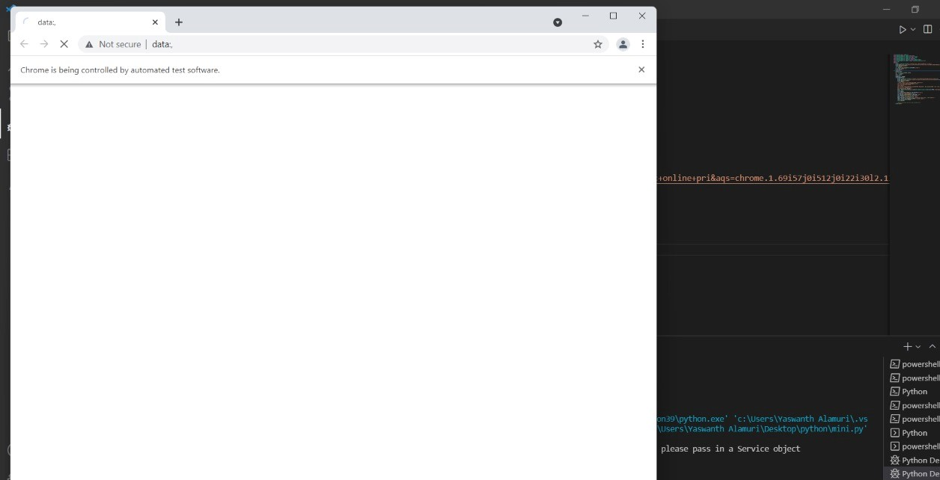
SOME PICTURES OF AUTOMATION:

Slide 8
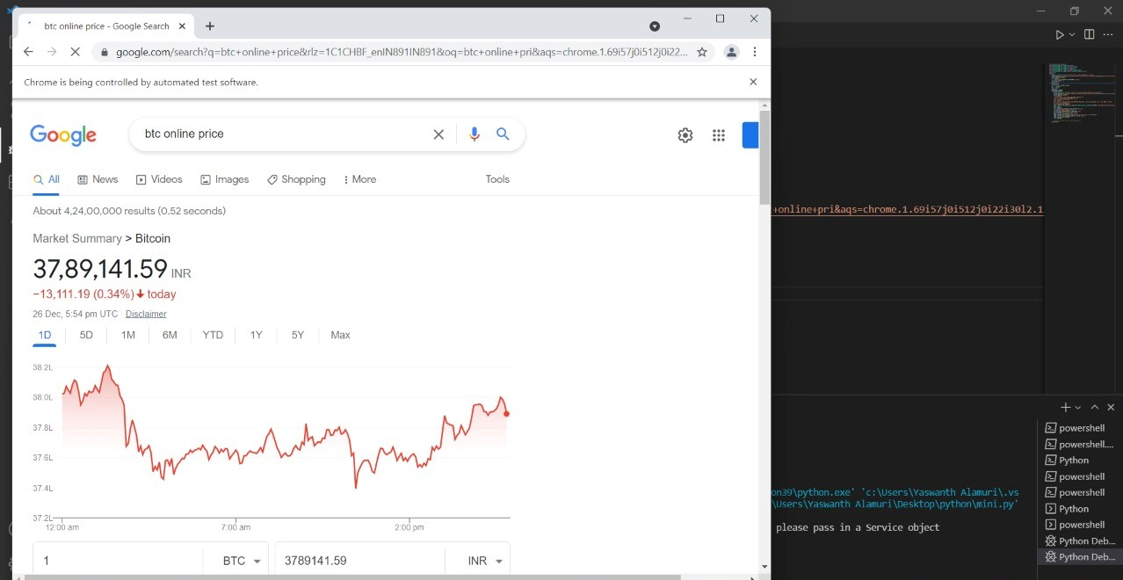
PROGRAM REDIRECTED TO BROWSER

Slide 9
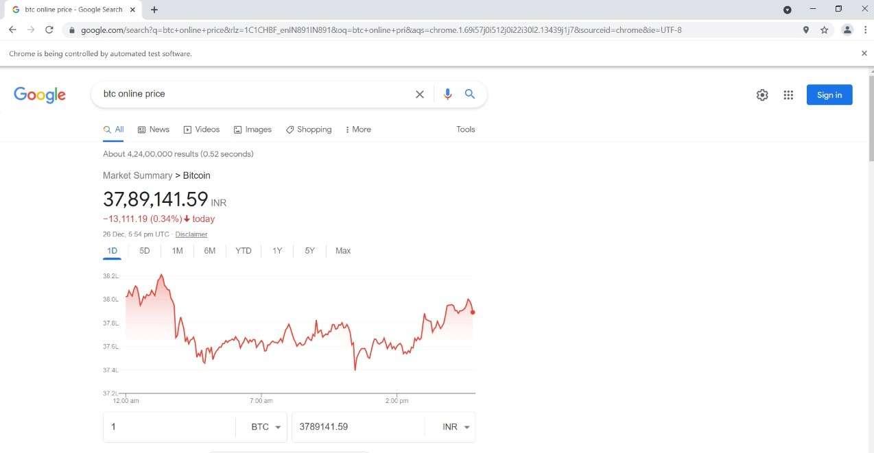
BROWSER WINDOW MAXIMIZED AND DELAY IS PROVIDED

Slide 10
OPERATION ON INFORMATION OBTAINED
THE INFORMATION WE GET WILL BE IN STRING DATATYPE WITH DECIMAL POINT VALUE.WE USE SPLIT() FUNCTION TO ELIMINATE THE DECIMAL VALUE AND THE OTHER REQUIRED VALUE IS STORED AS STRING IN A LIST.
WE ACCESS THE FIRST ELEMENT IN THE LIST AND ASSIGN TO OTHER VARIABLE AND PERFORM OPERATION TO OBTAIN REQUIRED DATA AS SHOWN BELOW
x=ps[0]
z=''
for i in x:
if i!=',':
i=str(i)
z=z+i

Slide 11
Sequence of steps to Send an email using smptlib module
Import smtp module:
import smtplib – to import the standard email library
Assign the server:
server = smtplib.SMTP_SSL("smtp.gmail.com",465)
here 465 is the SMTP server address for gmail
Provide login creditionals:
server.login(“samplemail@gmail.com",“PASSWORD")
send mail:
server.sendmail(“from mail”,”to mail”,”subject”)
Close the window:
server.quit()

Slide 12
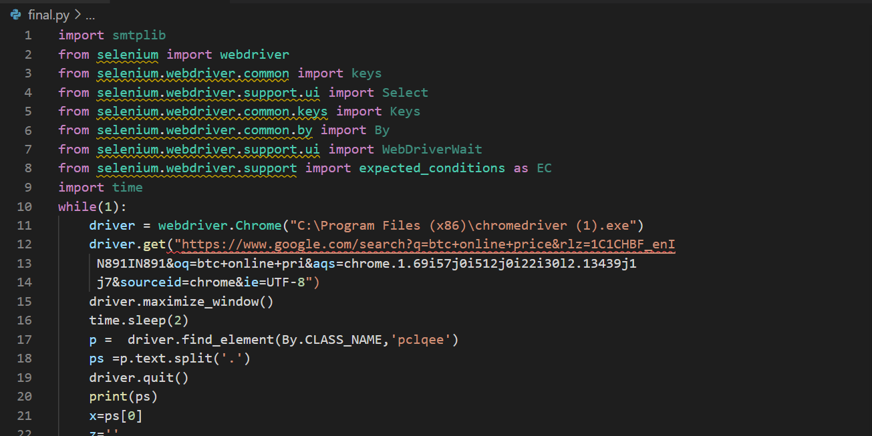
Coding

Slide 13
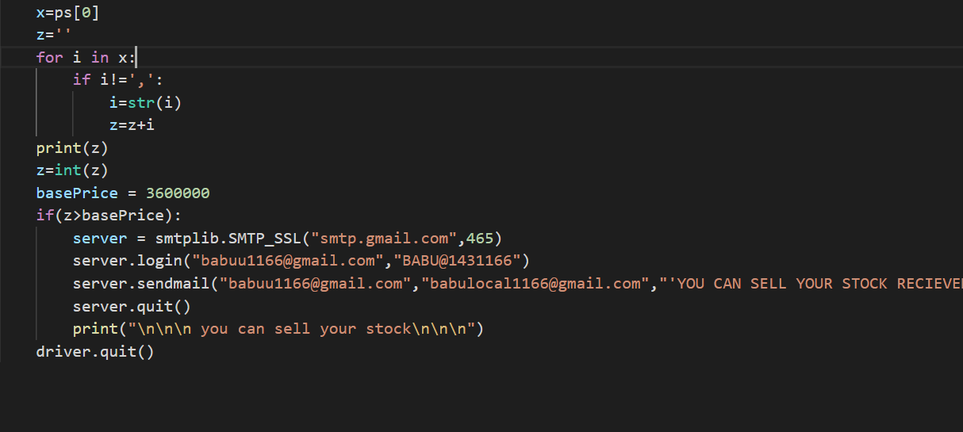

Slide 14
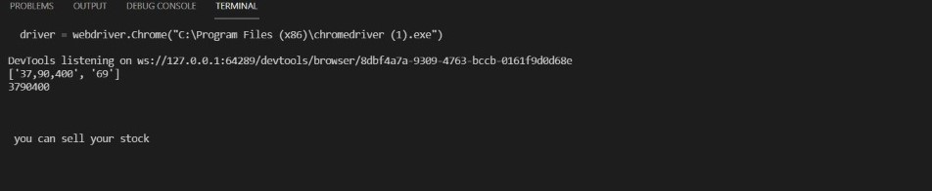
Output Screens
1.Command window output

Slide 15
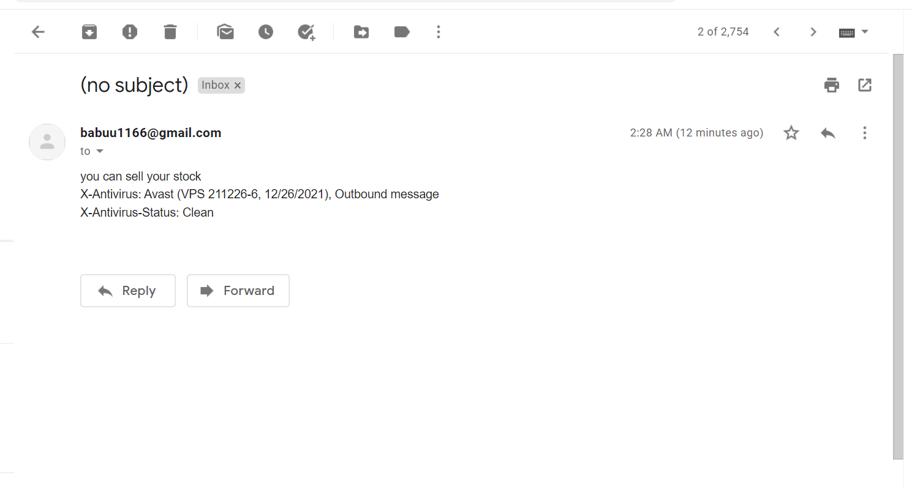
2.Conformation mail

Slide 16


BENEFITS:
Time saving
Price drop alerts
Price gain alert
Notification when there is a sudden change
Runs for every 30 sec

Slide 17
Conclusion:
I have used python program to analyze the stock price using selenium.By using selenium library we can handle a webbrowser.by selenium we import the price of the stock from online using keys functions.by using inspect tool we access the address of the data.by using this address we get the information required and we modify the information according to our necessity.once after the getting the price of the stock we compare it with base price given by the user.if the price is greater thanthe base price the user will be notified through mail.this stock analyzer is very useful for stock market analyzers which reduces burden on them .saves the time of the user.no need to check the price of the stock again and again.

Slide 18
References:
https://www.selenium.dev/
https://www.browserstack.com/guide/python-selenium-to-run-web-automation-test
https://www.geeksforgeeks.org/how-to-send-automated-email-messages-in-python/
https://www.youtube.com/watch?v=Y_tnWTjTfzY

Slide 19
THANK YOU

